Slide 1
1st law of Thermodynamics

Slide 2

The first law of thermodynamics is an extension of the law of conservation of energy
The first law of thermodynamics states that “while energy can be changed from one form to another, the total quantity of energy, E, in the universe is constant.”
Δ(Energy of the system) + Δ(Energy of surroundings) = 0

Slide 3
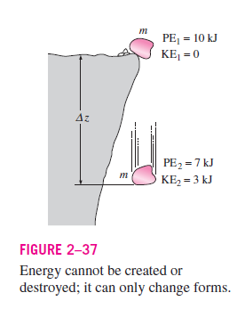
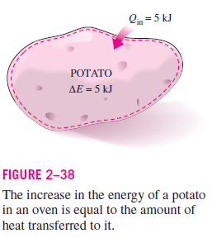
Although energy assumes many forms, the total quantity of energy is constant, and when energy disappears in one form it appears simultaneously in other forms.

Slide 4
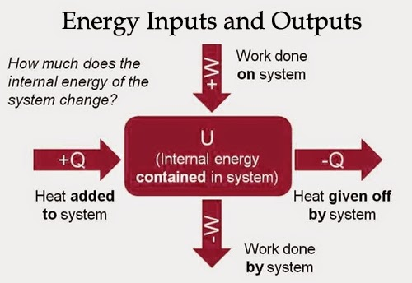
For a closed system, First law of thermodynamics can be restated as: the change in internal energy of a system is equal to the heat added to the system and the work done by the system
ΔU = ±Q ± W

Slide 5
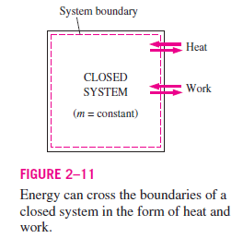
In a closed system, the transfer of energy between the surroundings and the system can only be accomplished by heat or by work.
Heat is the transfer of energy by a temperature gradient, whereas all other forms of energy transfer in a closed system occur via work.

Slide 6
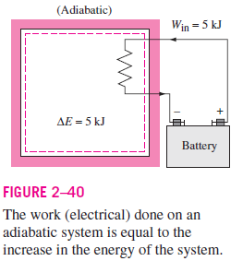
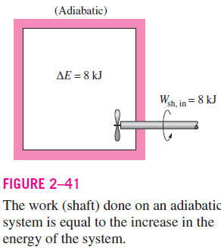
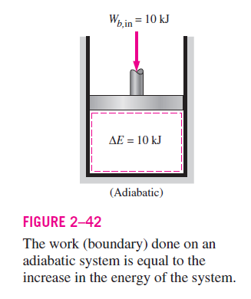

Slide 7
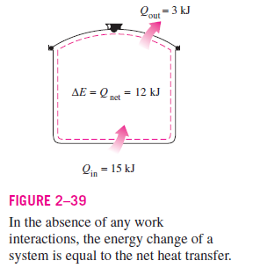
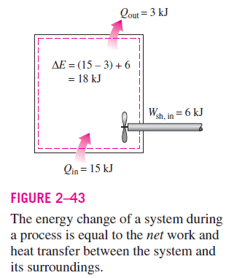

Slide 8
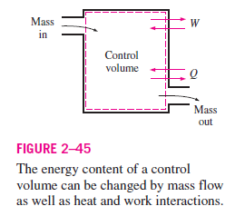
Energy can be transferred by heat, Q, by work, W, and, in the case of the open systems by the energy associated with the mass that flows into and out of the system.

Slide 9
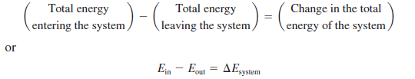
Energy Balance
The net change (increase or decrease) in the total energy of the system during a process is equal to the difference between the total energy entering and the total energy leaving the system during that process.

Slide 10

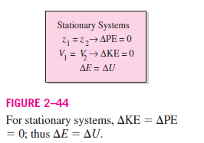
With reference to system and surrounding
Δ(Energy of the system) + Δ(Energy of surroundings) = 0
ΔE = ΔU + ΔK.E + ΔP.E
For stationary systems, the changes in kinetic and potential energies are zero (that is, KE = 0, PE = 0),
ΔE = ΔU

Slide 11
Mechanisms of Energy Transfer, E_{in} and E_{out}
Energy can be transferred to or from a system in three forms: heat, work, and mass flow.
The only two forms of energy interactions associated with a fixed mass or closed system are heat transfer (Q) and work (W).
Heat Transfer (Q)
Heat transfer to a system (heat gain) increases the energy of the molecules and thus the internal energy of the system,
Heat transfer from a system (heat loss) decreases the energy of the molecules since the energy transferred out

Slide 12
Work Transfer (W)
An energy interaction that is not caused by a temperature difference between a system and its surroundings is work.
A rising piston, a rotating shaft, and an electrical wire crossing the system boundaries are all associated with work interactions.
Work transfer to a system (i.e., work done on a system) increases the energy of the system
Work transfer from a system (i.e., work done by the system) decreases it since the energy transferred out as work comes from the energy contained in the system.

Slide 13
Mass Flow, (m)
Mass flow in and out of the system serves as an additional mechanism of energy transfer.
When mass enters a system, the energy of the system increases because mass carries energy with it (in fact, mass is energy).
Likewise, when some mass leaves the system, the energy contained within the system decreases because the leaving mass takes out some energy with it.
For example, when some hot water is taken out of a water heater and is replaced by the same amount of cold water, the energy content of the hot-water tank (the control volume) decreases as a result of this mass interaction (Fig. 2–45).

Slide 14
Noting that energy can be transferred in the forms of heat, work, and mass, and that the net transfer of a quantity is equal to the difference between the amounts transferred in and out, the energy balance can be written more explicitly as:
The heat transfer (Q) is zero for adiabatic systems, the work transfer (W) is zero for systems that involve no work interactions, and the energy transport with mass E_{mass} is zero for systems that involve no mass flow across their boundaries (i.e., closed systems).

Slide 15
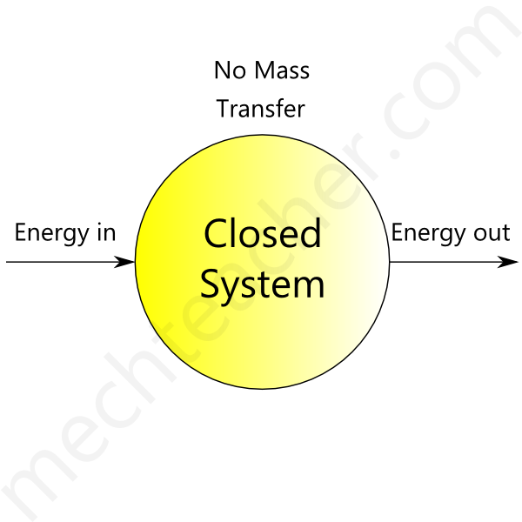
ENERGY BALANCE FOR CLOSED SYSTEMS
Closed System:
A closed system allows only energy (heat and work) to pass in and out of it. It does not allow mass transfer across its boundary. The following image shows a closed system
Example of closed system: Water heated in a closed vessel – Here only heat energy can pass in and out of the vessel

Slide 16
Because no streams enter or leave a closed system, no energy associated with matter is transported across the boundary that divides the system from its surroundings.
All energy exchange between a closed system and its surroundings is in the form of heat or work.
Closed systems often undergo processes during which only the internal energy of the system changes.
For such processes, First law of thermodynamics is given as
ΔU^{t} = Q + W
For differential changes in U^{t}
dU^{t} = dQ + dW (1)
Total internal energy U^{t} depend on the quantity of material in a system, and are called extensive properties

Slide 17
For a homogeneous system, an alternative means of expression for the extensive properties
U^{t} = nU
Where ‘U’ represent the internal energy of a material per unit mole.
Therefore eq (1) can be written as
d(nU) = dQ + dW
Which is the energy balance for a homogeneous closed system of n moles.
The work of a mechanically reversible, closed-system process is
dW = - Pd(nV)
These two equations combine:
d(nU) = dQ - Pd(nV)
This is the general first-law equation for a mechanically reversible, closed-system process.

Slide 18

Constant-Volume Process
If the process occurs at constant total volume, the work is zero. Moreover, for closed systems, because n and V are both constant. Thus,
d Q = d(nU) (const V)
Integration yields:
Q = n ΔU (const V)
Thus for a mechanically reversible, constant-volume, closed-system process, the heat transferred is equal to the internal-energy change of the system.
Notes:
The differentials of heat and work are not changes, but are infinitesimal amounts. When integrated, these differentials give not finite changes, but finite amounts.

Slide 19
Constant-Pressure Process
dQ = d(nU) + P d(nV)
For a constant-pressure change of state:
dQ = d(nU) + d(nPV) = d[n(U + PV)]
H = U+PV
Enthalpy (H) is the heat content of the system at constant pressure.
d Q = d(nH) (const P)
Integration yields:
Q = n ΔH (const P)
Thus for a mechanically reversible, constant-pressure, closed-system process, the heat transferred equals the enthalpy change of the system.
Change in enthalpy (ΔH) is the heat exchange by the system at constant pressure

Slide 20
MASS AND ENERGY BALANCES FOR OPEN SYSTEMS

Slide 21


Measures of Flow
Open systems are characterized by flowing streams; there are four common measures of flow:
The measures of flow are interrelated:
where ℳ is molar mass and A is the cross-sectional area for flow.
Importantly, mass and molar flow rates relate to velocity:
The area for flow A is the cross-sectional area of a conduit, and ρ is specific or molar density.
Flow rates m, n, and q represent measures of quantity per unit of time.

Slide 22
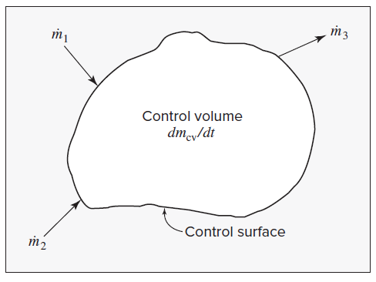
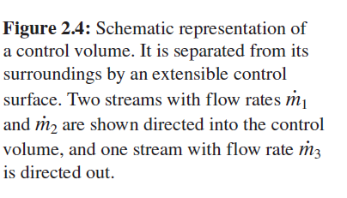
Mass Balance for Open Systems
Because mass is conserved, the rate of change of mass within the control volume, dm_{cv} / dt, equals the net rate of flow of mass into the control volume.
The convention is that flow is positive when directed into the control volume and negative when directed out.

Slide 23
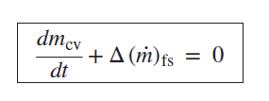




The mass balance is expressed mathematically by:
The subscript “fs” indicates that the term applies to all flowing streams.
For the control volume of Fig. 2.4, the second term is:
The difference operator ‘Δ’ here signifies the difference between exit and entrance flows,

Slide 24



Steady-state flow processes are those for which conditions within the control volume do not change with time. These are an important class of flow processes often encountered in practice.
In a steady-state process, the control volume contains a constant mass of fluid, and the first or accumulation term of Eq. (2.24) is zero, reducing Eq. (2.25) to:
When there is a single entrance and a single exit stream, the mass flow rate m ˙ is the same for both streams; then,
Because specific volume is the reciprocal of density,
In this form the mass-balance equation is often called the continuity equation.

Slide 25


The General Energy Balance
The rate of change of energy within the control volume equals the net rate of energy transfer into the control volume.
Streams flowing into and out of the control volume have associated with them energy in its internal, potential, and kinetic forms and all may contribute to the energy change of the system.
Each unit mass of a stream carries with it a total energy
where u is the average velocity of the stream, z is its elevation above a datum level, and g is the local acceleration of gravity.
Thus, each stream transports energy at the rate

Slide 26
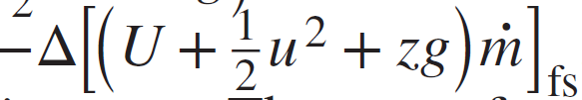

The net energy transported into the system by the flowing streams is therefore
Where the effect of the minus sign with “Δ” is to make the term read in – out.
The rate of energy accumulation within the control volume includes this quantity in addition to the heat transfer rate and work rate:
The work rate may include work of several forms. First, work is associated with moving the flowing streams through entrances and exits.

Slide 27
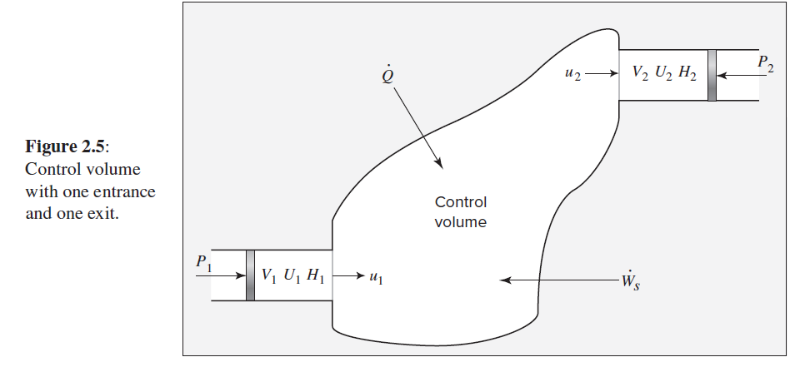
The fluid at any entrance or exit has a set of average properties, P, V, U, H, etc.
Imagine that a unit mass of fluid with these properties exists at an entrance or exit, as shown in Fig. 2.5.

Slide 28



The work done by this piston in moving the unit mass through the entrance is PV, and the work rate is .
Because Δ denotes the difference between exit and entrance quantities, the net work done on the system when all entrance and exit sections are taken into account is
Another form of work is the shaft work indicated in Fig. 2.5 by rate W_{s}
In addition, work may be associated with expansion or contraction of the entire control volume.
These forms of work are all included in a rate term represented by W .
The preceding equation may now be written:

Slide 29


Combination of terms in accord with the definition of enthalpy,
H = U + PV, leads to
which is usually written:

Slide 30

Energy Balances for Steady-State Flow Processes
Steady-state flow processes are those for which conditions within the control volume do not change with time.
Flow processes for which the accumulation term of Eq. given below, d(mU)_{cv}/dt, is zero are said to occur at steady state.
No expansion of the control volume is possible under these circumstances.

Slide 31


The only work of the process is shaft work, and the general energy balance, Eq. (2.27), becomes:
Further specialization results when the control volume has one entrance and one exit. The same mass flow rate m ˙ then applies to both streams, and Eq. (2.29) reduces to:
(Eq. 2.29)

Slide 32

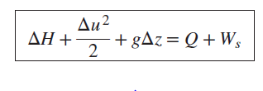
Division by m˙ gives:
Or
This equation is the mathematical expression of the first law for a steady-state, steady-flow process between one entrance and one exit.

Slide 33

In many applications, kinetic- and potential-energy terms are omitted because they are negligible compared with other terms.
For such cases
This expression of the first law for a steady-state, steady-flow process is analogous to Eq. given below for a nonflow process.
However, in Eq. (2.32), enthalpy rather than internal energy is the thermodynamic property of importance, and Δ refers to a change from inlet to outlet, rather than from before to after an event.

Slide 34
Heat Capacity
Heat Capacity of a system is defined is the amount of heat required to raise the temperature of the system through 1 degree Celsius (°C).
If ‘q’ is the amount of heat supplied to system and as a result, if the temperature of the system raises from T₁ and T₂, then the heat capacity of the system is given by:
C = q / (T₂-T₁)
C = q / ΔT

Slide 35


Molar heat capacity is the amount of heat energy required to raise the temperature of 1 mole of a substance through 1 (°C)
Specific heat capacity is the amount of heat energy required to raise the temperature of 1 kg of substance through 1 (°C)
There are two types of heat capacities
Heat capacity at constant volume (C_{v})
Heat capacity at constant pressure (C_{p})
Heat capacity at constant volume (C_{v}): the amount of heat required to raise the temperature of the system through 1 (°C) keeping the volume of the system constant
Integration yields:

Slide 36
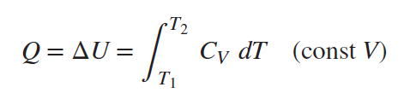




For a mechanically reversible, constant-volume process gives:
Heat capacity at constant pressure (C_{p}) : the amount of heat required to raise the temperature of the system through 1 (°C) keeping the pressure of the system constant
Integration yields:
For a mechanically reversible, constant-P process

